Slide 1
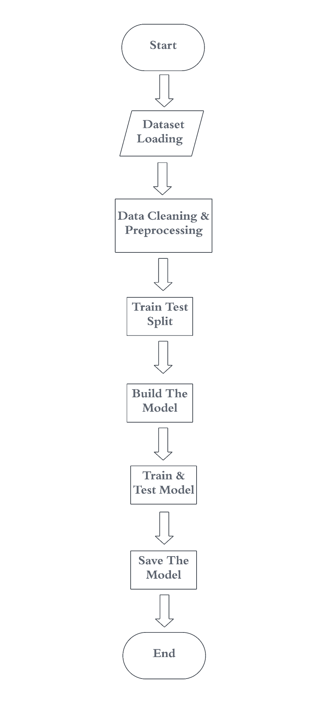
Methodology
Our methodology for project involves several key steps:
1. Data Preprocessing : :
- Construct a Word2Vec model for embeddings.
- Tokenize text and split the dataset into training and testing sets.
- Pad sequences for uniform input size and encode labels numerically.
2. Model Implementation :
- Develop Simple RNN and GRU models using Keras.
- Train the model with input and test the result.
4. Model Saving :
- Save models, tokenizer, and encoder using pickle for future use.
5. Application :
- Create a user-friendly app for real-time mood detection, model interaction, and assistance features.
Flow Diagram

Slide 2
Algorithm
For the sentimental Analysis we use Simple RNN and GRU
Simple RNN (Recurrent Neural Network ):
Sequential Data Processing: Effective for handling sequences of data such as text, capturing temporal dependencies.
Memory: Maintains a hidden state to remember previous inputs, which is crucial for understanding context in sentences.
Simplicity: Easier to implement and understand, making it a good starting point for sequence-based tasks like sentiment analysis.
GRU (Gated Recurrent Unit) :
Improved Long-term Dependency Handling : Addresses the vanishing gradient problem better than Simple RNN, allowing for better capture of long-term dependencies.
Gate Mechanisms : Incorporates reset and update gates to control the flow of information, enhancing the model’s ability to retain and forget information as needed.
Efficiency: Requires fewer parameters and computational resources compared to LSTM, making it faster to train while still being powerful.
Performance : Often outperforms Simple RNN in sentiment analysis tasks due to its ability to model complex dependencies without the risk of gradient issues.

Slide 3
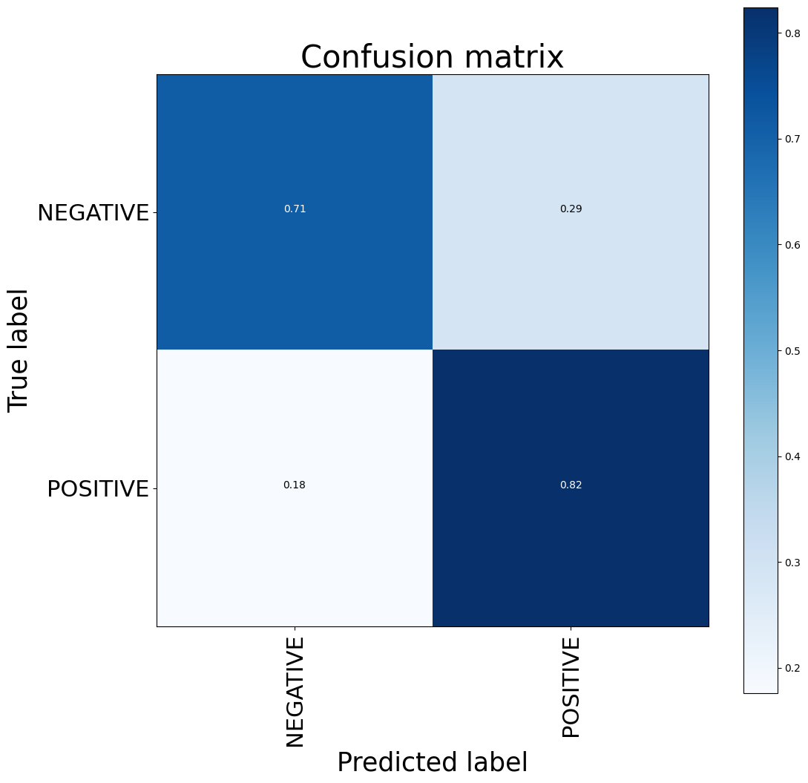
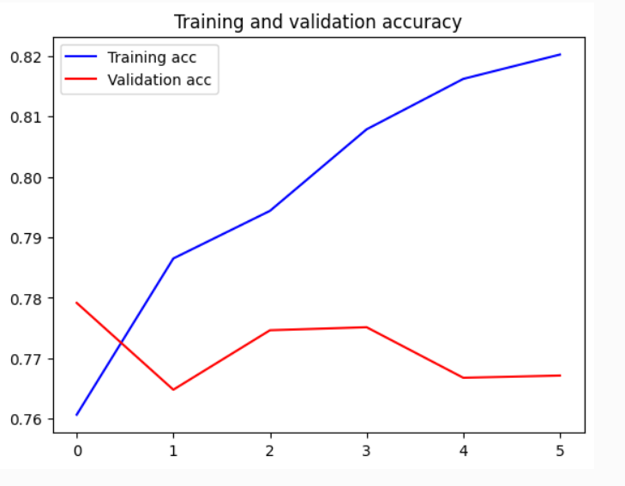
Result
Simple RNN

Slide 4
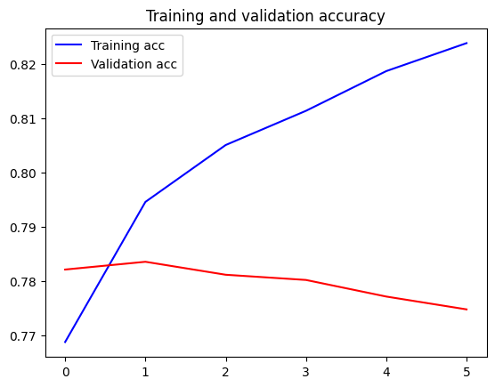
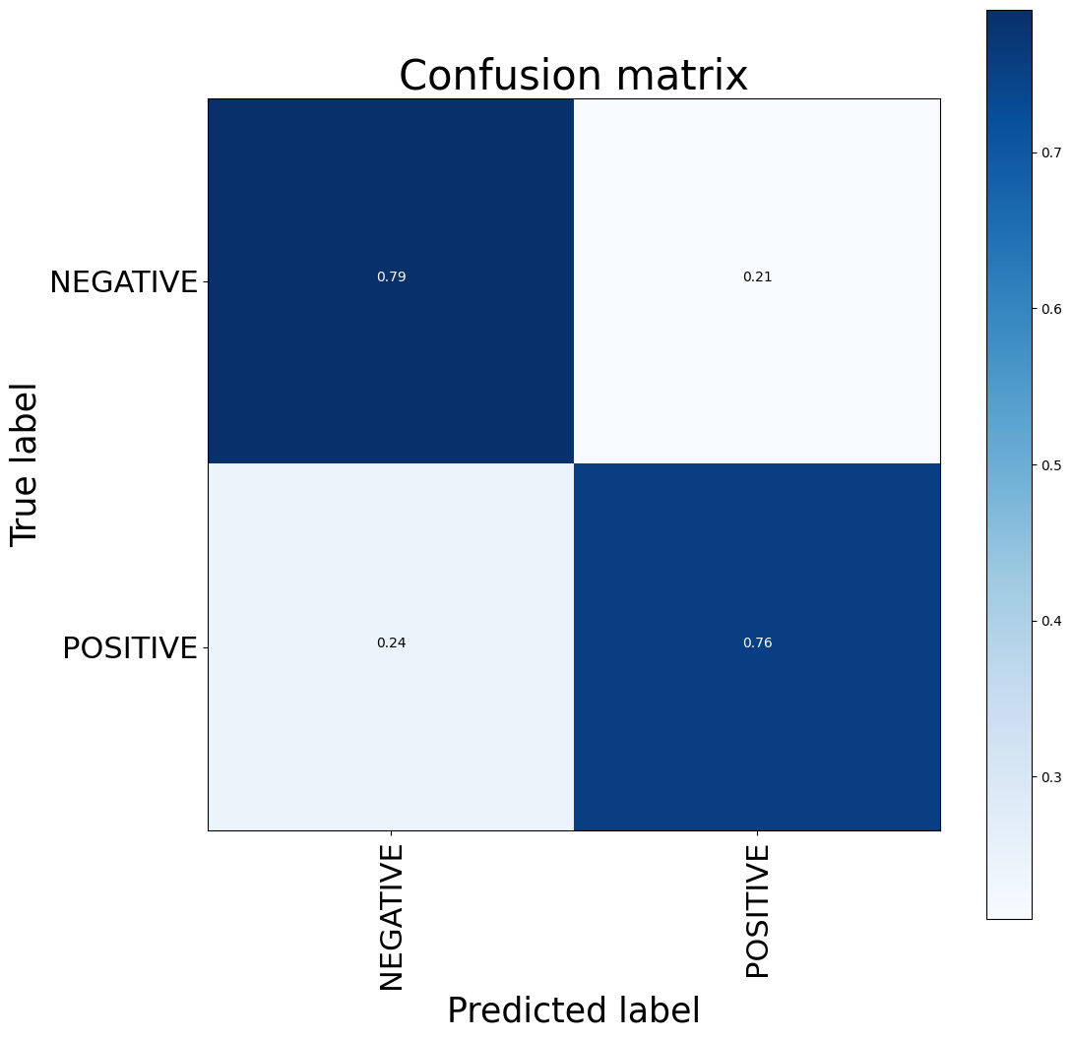
GRU

Slide 5
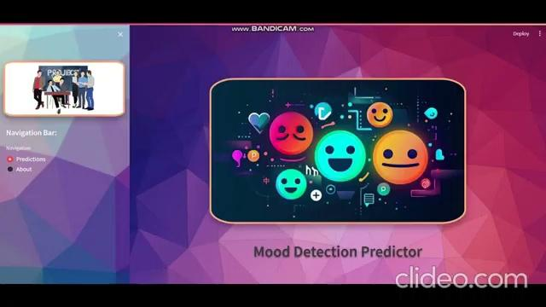
Website Output Screen

